Slide 1
2020-2021 Title I Annual Meeting Elizabeth Andrews High School
October 8, 2020 at 4:30 p.m.

Slide 2
Agenda
Overview of Title I Program
Title I Funds and Spending
Title I Budget
Parent and Family Engagement Budget
School Improvement (1003a) if applicable
School-wide Goals
CCRPI
CSIP
School-wide Programs & Supports
Curriculum & Instruction
Assessments
Local Assessments, GA Milestone Assessments, WIDA, ACCESS, and Alternate Assessments

Slide 3
Agenda
Parent and Family Engagement
District’s Parent and Family Engagement Policy
School’s Parent and Family Engagement Policy
School-Parent Compact
Teacher Professional Qualifications
Parent’s Right to Know
Opportunities the School Provides for Family Engagement
School and/or home
Volunteers
Parent Councils
School Communication Procedures
Parent Teacher Conferences
Closing and evaluations

Slide 4
Welcome

Slide 5
What is a Title I School?
Title I is a federal program that provides supplemental funding to local school districts to help ensure that all children, particularly the most academically at-risk students, meet the state’s high academic standards.

Slide 6
Title I Program Overview
Our school has been identified as a Title I School. Schools with high numbers or high percentages of children from low-income families are provided financial assistance through Title I to support school efforts tied to challenging state academic standards in order to reinforce and enhance efforts to improve teaching and learning for students.
Title I programs are based on effective means of improving student academic achievement and include strategies to support parent and family engagement. Funds are allocated to additional staff, instructional supplies and equipment, technology, and extended student learning opportunities.

Slide 7
Schoolwide Title I Budget
Provide stakeholders with a copy of the school’s proposed 2020-2021 Schoolwide Title I Budget.
Discuss Title I budget priorities.
Allow stakeholders an opportunity to ask questions
and record comments on the feedback form.

Slide 8
1% Set-aside for Parent and Family Engagement Budget
Parents and families must have input on how the Title I Parent and Family Engagement funds are used. Feedback was collected through surveys, feedback forms, and input given at our Stakeholder’s Input Meetings. Our school will use our Parent and Family Engagement Budget for the following:
Additional supplies and materials for the parent resource room,
such as books or educational games for parents and families to check
out.

Slide 9
School Improvement Budget for CSI, TSI, or Promise Schools (If applicable)
Elizabeth Andrews High School has been identified as a CSI Alternative Improvement School. An alternative education school: lowest 5%: graduation rate less than or equal to 67%. The next slides will detail the strategies for the FY20 school year that are designed to provide additional support to increase student achievement.

Slide 10
School Improvement Budget for CSI, TSI, or Promise Schools (If applicable)
Uploaded in the chat

Slide 11
CCRPI Data & Comprehensive Needs Assessment
Strengths
Our goal at Elizabeth Andrews High School is for all students to graduate and be college and career ready. Over three years, we had a two-year increase in the graduation rate of our 5-year Cohort and we took a slight decrease during our third year 2019. We strived for 70% graduation rate. We improved from 39.314% (2017) to 40.07 (2018) and took a slight decrease to 35.35 (2019) for our 5-year Cohort. Giving the nature of our school and the nature in which we receive our students, this growth is insurmountable. The overall College and Career Readiness Performance Index (CCPRI) scores have shown a slight decline over a two-year period; however, during this third year we have shown an increase. The CCRPI score three-year trend from 2017 to 2019 are 53.3, 37.6, and 42.5 respectively. EAHS applauds the level of growth accomplished by our teachers, holistically with 70% of the student population meeting typical/high growth on CCRPI. Academic success has improved in several areas over the past three years. Notably, our EOC (End of Course) scores for Ninth Grade Literature and Composition, American Literature, U.S. History, and Economics have increased.

Slide 12
CCRPI Data & Comprehensive Needs Assessment
Strengths
The students scoring at the developing level or better on the Ninth Grade Literature and Composition has improved over the past three years from 34.037% (2017) to 36.2% (2018) to 66% (2019). The students scoring at the developing level or better in American Literature grew from 28.022% (2017) to 32.3% (2018) to 41.3% (2019). The CCRPI progress for English Language Arts (ELA) is 93.46%. Students scoring at the beginning level on the US History decreased from 76.136% (2017) to 53.8% (2018) with a slight increase to 56.7% in (2019). The students scoring at the beginning level of Economics decreased and increased from 57.018% (2017) to 41.1% (2018) to 53.9 % (2019). The implementation of the Collaborative Planning Initiative has supported the disaggregation of data and ability to use data to impact instruction. Our ELL students have demonstrated growth on the GA Milestones in the areas of Science and English. Our ELL Science scores improved from 5.8% developing in 2018 to 19.44% developing in 2019. Our ELL English scores improved from 16.67% developing in 2018 to 25.71% developing in 2019 on the GA Milestones. According to CCRPI results, EAHS has to few students to calculate SWD data.

Slide 13
CCRPI Data & Comprehensive Needs Assessment
Gaps
According to 2019 CCRPI, EAHS has 698 students consisting of 231 males and 184 females in grades 10th through 12th. The total number of students in each grade level is as follows: 102 students in 10th grade, 118 students in 11th grade and 195 students in 12th grade. The student population represents a wide array of ethnic and socioeconomic groups, totaling seven ethnicities to include, Hispanic/Latino (16.9%), American Indian or Alaska Native (0%), Asian (3.7%), Black or African American (76.9%), Native Hawaiian or Other Pacific Islander, White (1.6%), ELL (17.5%), Students with Disabilities (9.6%), and Multi-Racial (.9%). The percentage of student population excluding White not of Hispanic Origin is 98.34%. Data analysis clearly shows that there is an achievement gap among our subgroups CCRPI Progress for English Language Proficiency (ELP) is 62%; as a result, we have been working earnestly to close that gap and have shown improvement in several areas. Through various initiatives and deliberate fiscal and personnel resources, EAHS has identified targeted interventions and programs to support ELL. EAHS has identified multiple areas where improvement is needed based on our three-year data trend; notably, the EOC (End of Course) scores from Coordinate Algebra, Analytic Geometry, Biology, and Physical Science. The students scoring at the beginning level of Coordinate Algebra, although high, has continued to fluctuate from 70.238% (2017) to 53.3% (2018) back to 73.5% (2019). The students scoring on the beginning level of Analytic Geometry, although high, has been declining from 86.25% (2017) to 70.9% (2018) to 66.7% (2019).

Slide 14
CCRPI Data & Comprehensive Needs Assessment
Gaps
With the implementation of Collaborative Planning, we will keep our focus on the data and look for ways to impact instruction. The CCRPI Progress for Math is 66.67%. The Science specific data has fluctuated up and down over the past three years. The students scoring on the beginning level in Biology went from 54.4% (2016) to 75% (2017) to 63.2% (2018). The students scoring on the beginning level in Physical Science has also fluctuated from 71.7% (2017) to 57.4% in (2018) to 65.4% (2019). More students fell in the beginning achievement level in 2017 when compared to 2018; however, the number has increased again in 2019. The students scoring at the developing level or better in American Literature grew from 28.022% (2017) to 32.3% (2018) to 41.3% (2019). The CCRPI progress for English Language Arts (ELA) is 93.46%. Our ELL students had a decrease in student performance in Social Studies from 2018 to 2019. Social Studies scores dropped form 41.67% passing in 2018 to 37.32% passing in 2019. In addition, based on our 4-year cohort graduation rate our numbers reflect the following: 2017,11.5%; 2018,17.7%; 2019 13%. Although our graduation rate has fluctuated up and down the past three years, we are still below the DSCD average of 74.9% and the GDOE average of 82.6%. We must continue to focus on our graduation rate with an emphasis on providing support to our English Language Learners and our Students with Disabilities. According to CCRPI results, EAHS has to few students to calculate SWD data

Slide 15
Continuous School Improvement Plan
Priority Areas 1, 2, 3
Improving Proficiency in Science; Biology and Physical Science
Improving Mathematical Efficiency
Improving Literacy
Improvement Strategies
Three-Dimensional Learning, Full Implementation of 5E Lesson Delivery
Incorporate Math Numeracy, Increase Math Vocabulary and Language Acquisition
Disciplinary Literacy, Building Reading Comprehension

Slide 16
Schoolwide Title I Program
Share the process for developing the Comprehensive Needs Assessment (CNA)
Review schoolwide Title I initiatives and programs
Provide information about your Continuous School Improvement Plan including:
Priority Areas 1, 2, 3
Improving Proficiency in Science; Biology and Physical Science
Improving Mathematical Efficiency
Improving Literacy
Improvement Strategies
Three-Dimensional Learning, Full Implementation of 5E Lesson Delivery
Incorporate Math Numeracy, Increase Math Vocabulary and Language Acquisition
Disciplinary Literacy, Building Reading Comprehension

Slide 17
Schoolwide Title I Program
Parent and Family Engagement Supports
Our Parent Liaison will provide stakeholders information and opportunities to give input, feedback, and request resources to assist their children at home with supporting the Three Dimensional Learning process; numeracy; math vocabulary; language acquisition; literacy; building reading comprehension; and the 5E instructional process as well as to help with their child’s transition to the next grade. Translations will be made available based on need/requests(stakeholder input meetings, annual meeting, Curriculum Night, Core Content Nights, CSIP, compact and policy development, parent/teacher conferences, email, website).

Slide 18
Curriculum & Instruction
Moving from Theory to Practice
Teachers will participate in professional learning, provided by Dekalb County School District, Local school, and state.
Focus on meeting needs of students

Slide 19
What is Parent and Family Engagement?
Parent engagement is an ongoing process that increases active participation, communication, and collaboration between parents, schools and communities with the goal of educating the whole child to ensure student achievement and success. The Georgia Department of Education and DeKalb County School District ensures that Title I, Part A, Parent and Family Engagement Programs are met with meaningful and strategic actions to build parent capacity as mandated by the Every Student Succeeds Act (ESSA) of 2015.
Our school must ensure that strong strategies are in place to:
Build capacity to involve parents/stakeholders in an effective partnership.
Share and support high student academic achievement.

Slide 20
Parent and Family Engagement Policy
The purpose of the district’s and school’s parent and family engagement policy is to establish the district’s and school’s expectations for family engagement and describes how the district and school will implement a number of specific parent and family engagement activities.

Slide 21
Distribution of District’s Parent and Family Engagement Policy
The District Parent and Family Engagement Policy will be distributed at our school in the following ways:
Available in the Parent Center
Posted on the Elizabeth Andrews High school Website on the Parent Tab for the 2020-2021 school year

Slide 22
Distribution of School’s Parent and Family Engagement Policy
The School Parent and Family Engagement Policy will be distributed at our school the following ways:
The Annual Title I Meeting
Email or text message with attachments or links to documents posted online
Policy will be available in the Parent Resource Center, front office and school website

Slide 23
Distribution of School’s Parent and Family Engagement Policy
The School Parent and Family Engagement Policy will be distributed at our school the following ways:
The Annual Title I Meeting
Email or text message with attachments or links to documents posted online
Policy will be available in the Parent Resource Center, front office and school website

Slide 24
School Policy

Slide 25
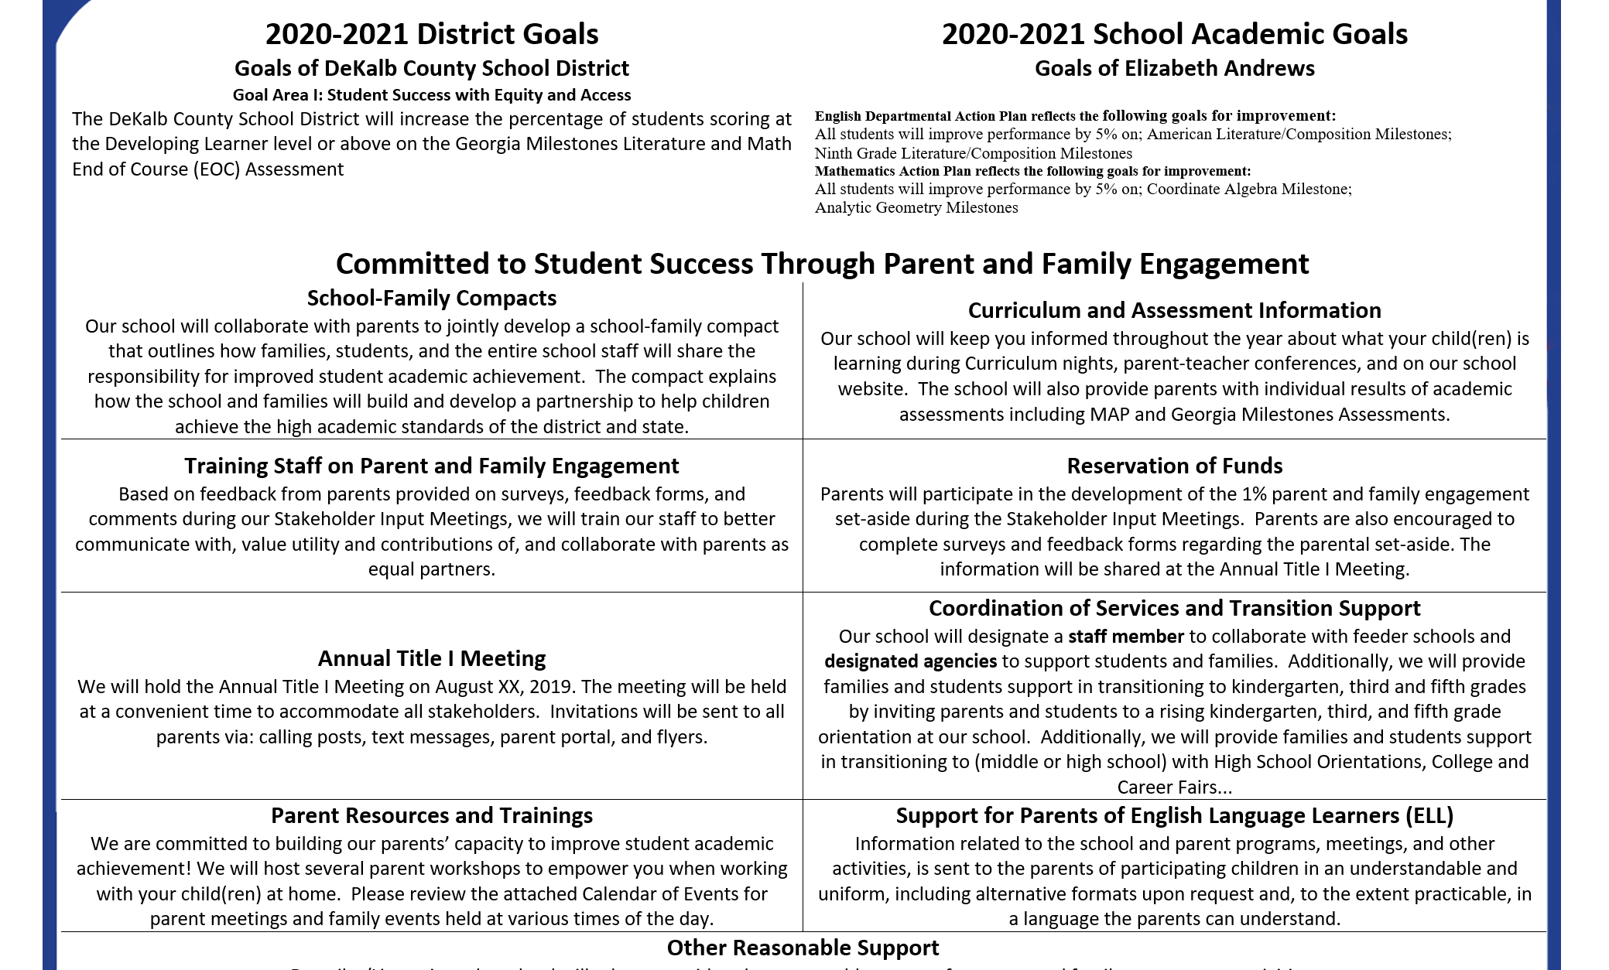
School Policy

Slide 26
What is a School-Family Compact?
The purpose of a school-family compact is to form an agreement that parents, students, and teachers develop together. It explains how parents and teachers work together to ensure all students receive the individual support they need to reach and exceed grade level academic standards.

Slide 27
Distribution of School-Family Compact
Our School-Parent Compact will be distributed at our school in the following ways:
The Annual Title I Meeting
Email or text message with attachments or links to documents posted online
Policy will also be available in the Parent Resource Center, front office and school website

Slide 28
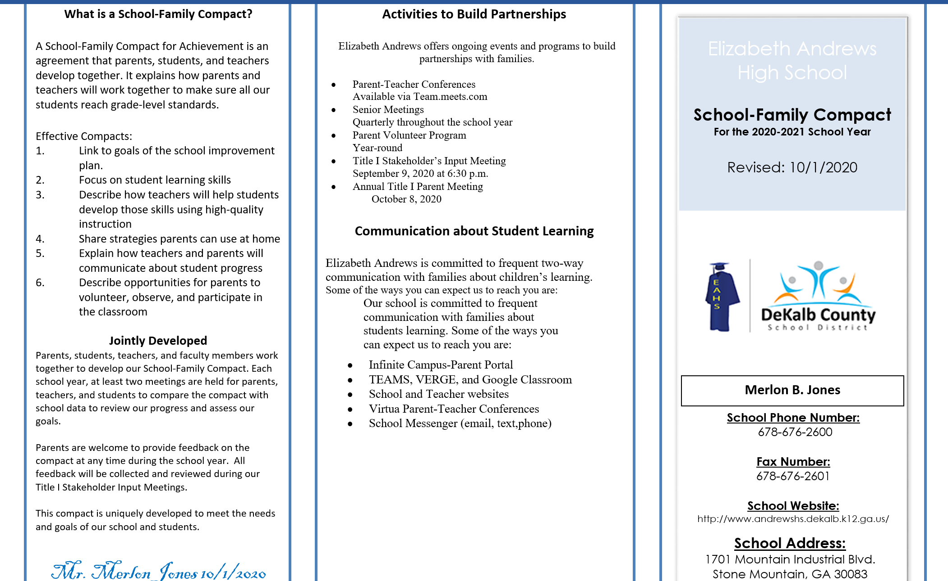
School Compact

Slide 29
School Compact

Slide 30
Professional Qualifications of Teachers Parent’s Right to Know Letter
Under ESSA, parents have a right to request professional qualifications of their children’s teacher(s) or paraprofessional(s). The Parent Right to Know letter will be made available through various methods Infinite Campus, email, flyer, and school website.
The purpose of this letter is to inform you of the right to ask for the following information about your children’s classroom teachers or paraprofessionals at this school.

Slide 31
Parent Volunteer & Engagement Opportunities
Opportunities the school offers for our families to be engaged at school and/or home.
Parent Advisory Council
Parent Volunteers
Parent/Teachers Conferences
Parent Workshops
Our school welcomes parents and community members to come volunteer with us. If you are interested in volunteer opportunities, please contact Pamela Mathis at 678-676-0384 or at Pamela_Mathis@dekalbschoolsga.org

Slide 32
Additional questions, comments, or suggestions

Slide 33
Contact Us
Elizabeth Andrews High School
Iris Simmons, Parent Liaison
1701 Mountain Industrial Blvd.
678-676-2644
http://www.andrewshs.dekalb.k12.ga.us/

Slide 34
DeKalb County School District’s mission is to ensure student success, leading to higher education, work and life-long learning.

